Slide 1






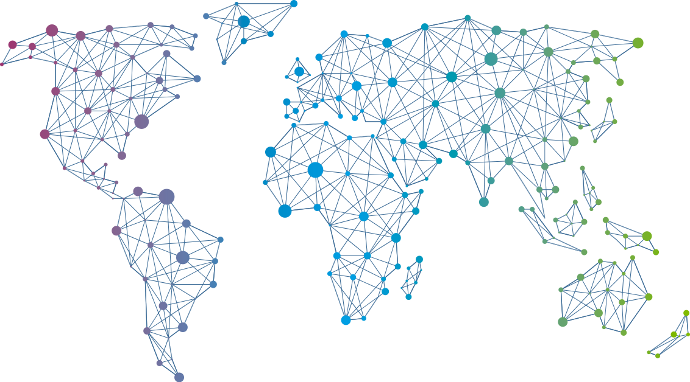

Speaker
Amber Erickson & Anam Navied
PowerShellGet: Today and Tomorrow
Amber Erickson
Anam Navied
amberlerickson
NaviedAnam
September 16th & 17th
^{Online Event}
Powered By
International Conference

